Slide 1
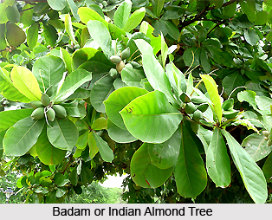
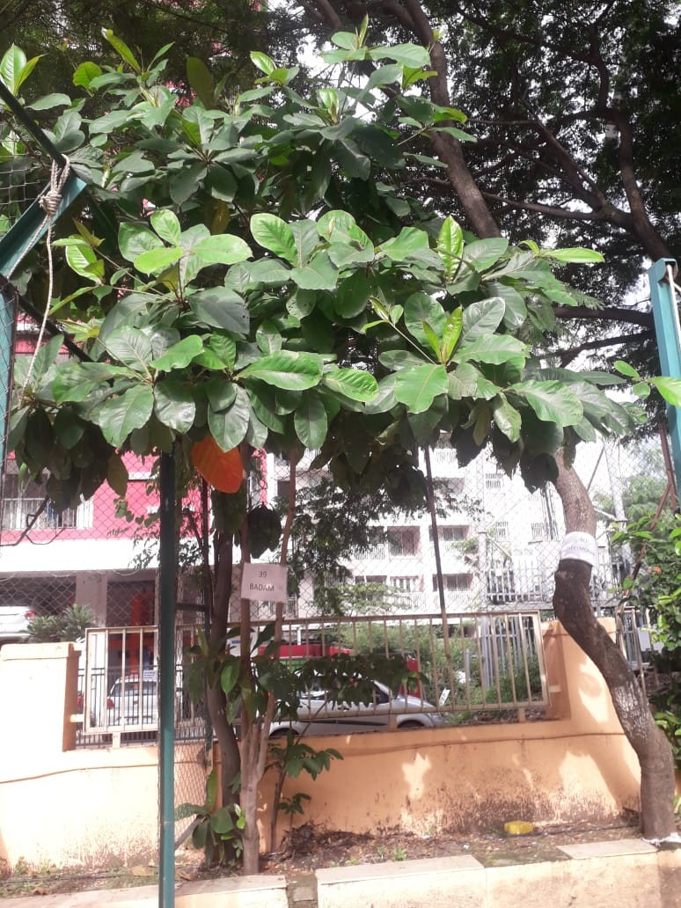
INDIAN ALMOND TREE
Near turf court-AIS campus Wakad

Slide 2
Common Name : Badaam or Almond
Scientific Name : Prunus dulcis
Family : Rosaceae
Habit : Prunus dulcis is a deciduous, flowering tree that
thrives in Mediterranean climates, characterized
by its early spring blossoms and edible nuts.
Distribution : The almond tree is primarily distributed across
Mediterranean regions, including parts of Southern
Europe, North Africa, and Western Asia, and has
been introduced to temperate areas worldwide for
commercial cultivation.

Slide 3
Description
The almond tree is a medium-sized deciduous tree that typically grows to about 10-15 feet in height, with a broad, spreading canopy.
It features lance-shaped, serrated leaves and produces delicate, pink or white blossoms in early spring.
The tree bears a fruit with a hard outer shell encasing the edible nut , known as badam or almond, which ripens in late summer.

Slide 4
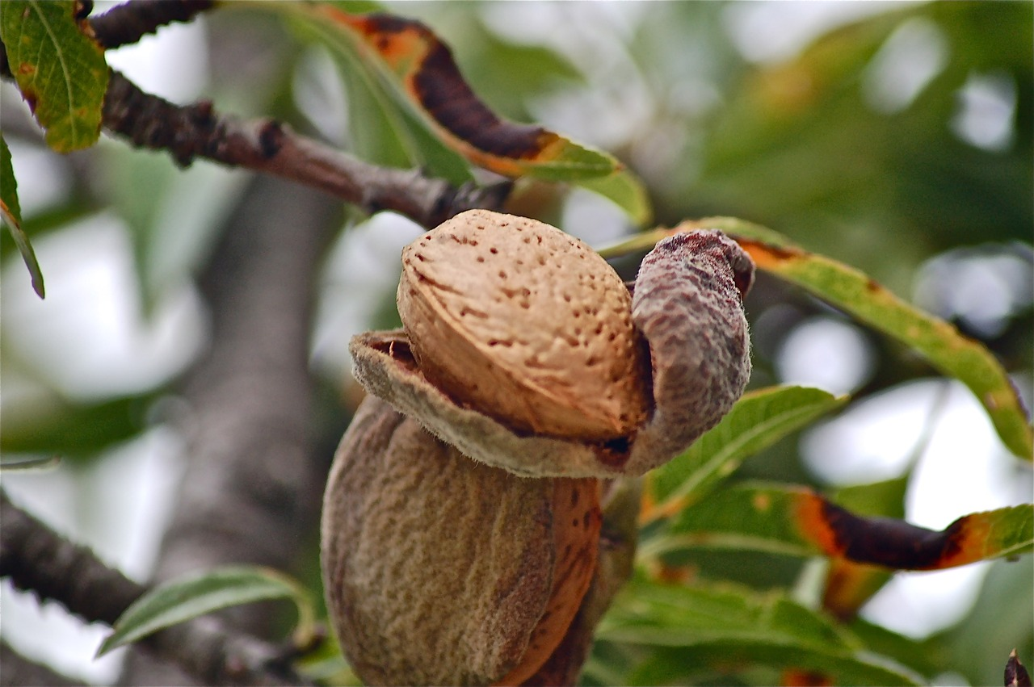
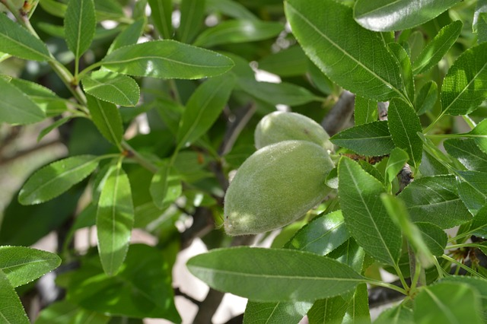
Uses

Slide 5
Culinary: Almonds are widely used in cooking and baking, both as whole nuts in
forms like almond flour, almond milk, and almond butter.
Cosmetics: Almond oil is used in skincare and haircare products for its
moisturizing and nourishing properties.
Ornamental: The almond tree is also valued for its beautiful spring blossoms and
is often used in landscaping.
Medicinal: Almonds are sometimes used in traditional medicine for various
health benefits, including aiding digestion and reducing cholesterol.
Almonds are high in vitamin E.
Almonds can lower cholesterol levels.

